Slide 1
Android Programming :Input Widget and Event Handling
Prof. Seongwook Youn
Department of Software
Korea National University of Transportation

Slide 2
3 Ways to create Listener Object
Define inner class
Define anonymous class
Implement listener interface in activity class

Slide 3
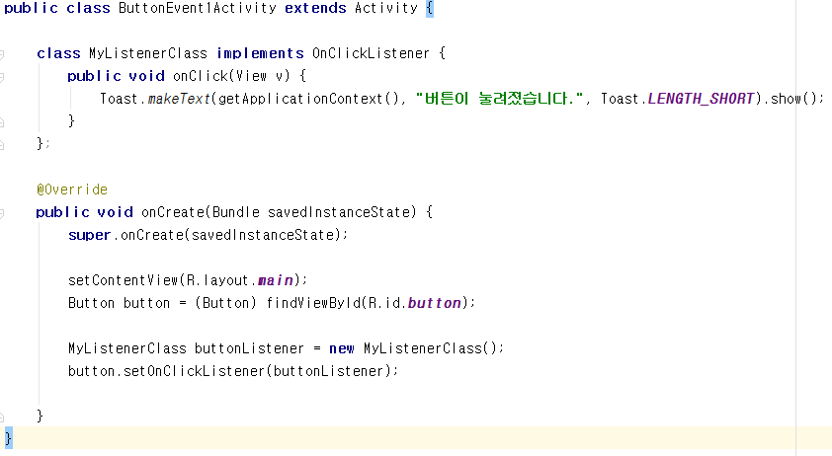
1. Event Handling using an Inner Class
Define class
Create event listener object
Register event listener object to the button

Slide 4
Toast
A toast provides simple feedback about an operation in a small popup. It only fills the amount of space required for the message and the current activity remains visible and interactive.
makeText(Context context, CharSequence text, int duration)
Context – Current application context
Text – Text message want to display
Duration – duration time (LENGTH_SHORT, LENGTH_LONG)
Example
Notes:
ButtonEvent1

Slide 5
2. Event Handling using anonymous class
...
public class ButtonEvent2Activity extends Activity {
@Override
public void onCreate(Bundle savedInstanceState) {
super.onCreate(savedInstanceState);
setContentView(R.layout.main);
Button button = (Button) findViewById(R.id.button);
button.setOnClickListener(new OnClickListener() {
public void onClick(View v) {
Toast.makeText(getApplicationContext(),
"버튼이 눌려졌습니다", Toast.LENGTH_SHORT).show();
}
});
}
}

Slide 6
Anonymous Class
The body of class is defined, but there is no name of class
Class definition and object creation are happened simultaneously
class ClickListener implements OnClickListener {
...
}
obj = new ClickListener();
obj = new OnClickListener() { .... };

Slide 7
Code Analysis
...
public class ButtonEvent2Activity extends Activity {
@Override
public void onCreate(Bundle savedInstanceState) {
super.onCreate(savedInstanceState);
setContentView(R.layout.main);
Button button = (Button) findViewById(R.id.button);
button.setOnClickListener(new OnClickListener() {
public void onClick(View v) {
Toast.makeText(getApplicationContext(), "버튼
눌려졌습니다", Toast.LENGTH_SHORT).show();
}
});
}
}
Use anonymous class
Notes:
buttonEvent2 실행하여 차이점 확인

Slide 8
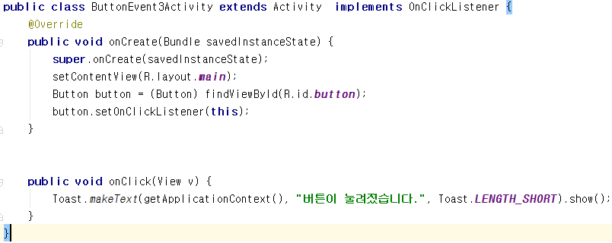
3. Implement listener interface in activity class
Notes:
ButtonEvent3

Slide 9
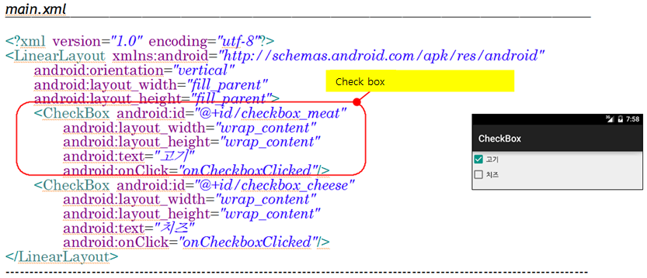
Check Box
Define check box in XML
An on/off switch that can be toggled by the user. You should use checkboxes when presenting users with a group of selectable options that are not mutually exclusive
Notes:
하나의 그룹 안에서 여러 개를 동시에 선택할 때 사용하는 위젯

Slide 10
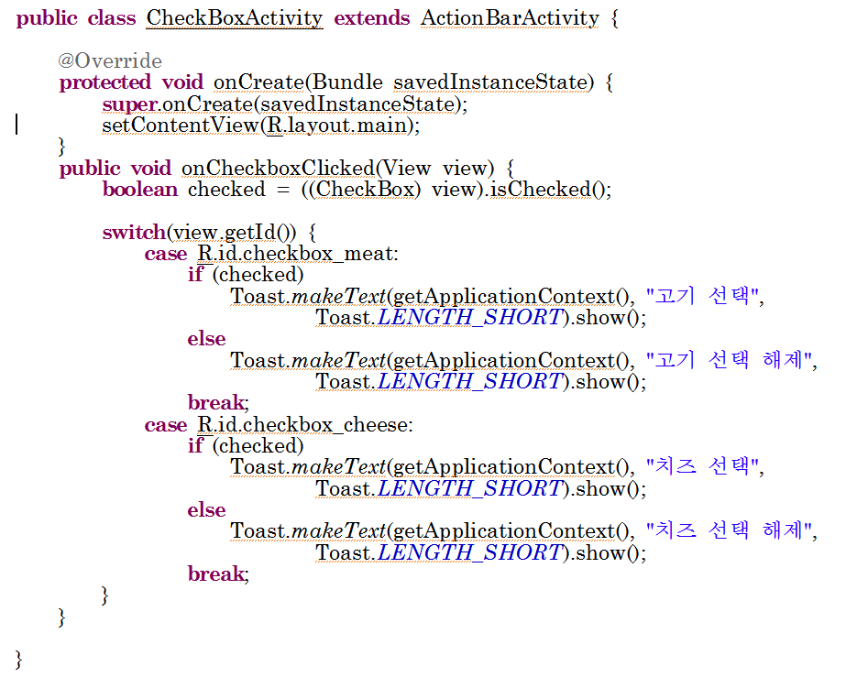
Event Handling of Check Box
Notes:
CheckBox 실행

Slide 11
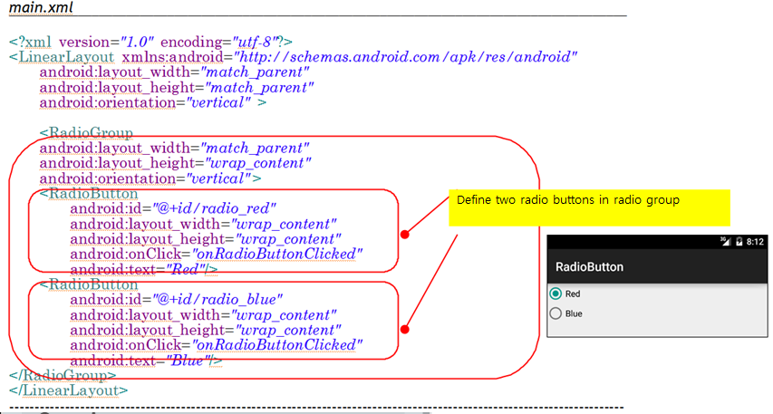
Radio Button
Define radio button in XML
Notes:
하나의 그룹 안에서 한 개의 버튼 선택

Slide 12
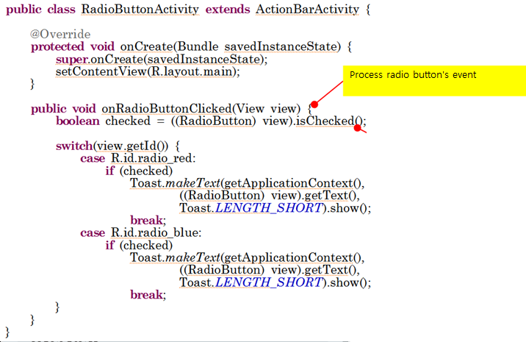
Event Handling of Radio Button

Slide 13
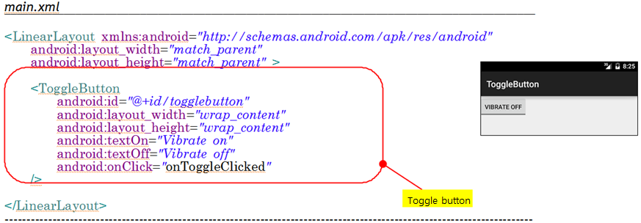
Toggle Button
Define toggle button in XML

Slide 14
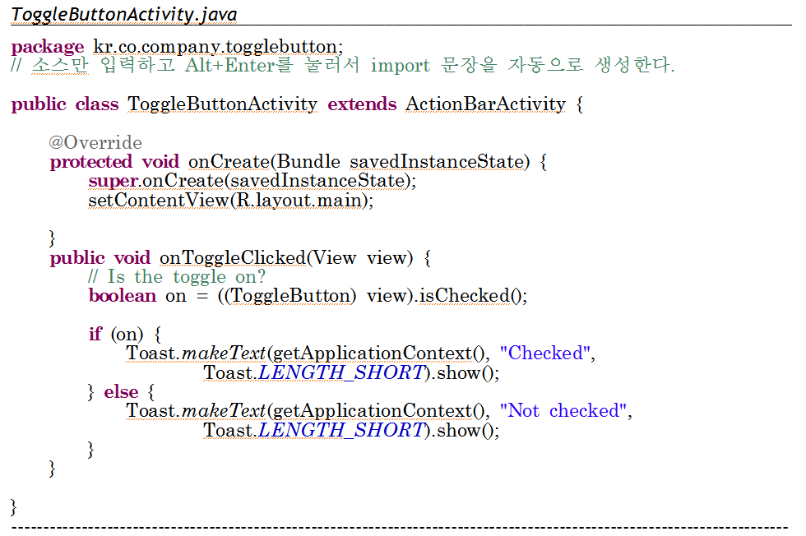
Toggle Button
Notes:
ToggleButton 실행

Slide 15
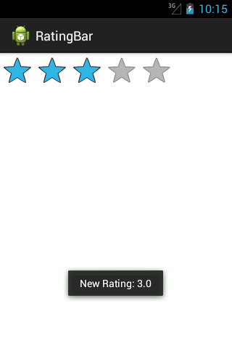
Rating Bar
...
<RatingBar
android:id="@+id/ratingbar"
android:layout_width="wrap_content"
android:layout_height="wrap_content"
android:numStars="5"
android:stepSize="1.0"
/>

Slide 16
Rating Bar
…
public class MainActivity extends Activity {
@Override
public void onCreate(Bundle savedInstanceState) {
super.onCreate(savedInstanceState);
setContentView(R.layout.activity_main);
final RatingBar ratingbar = (RatingBar) findViewById(R.id.ratingbar);
ratingbar.setOnRatingBarChangeListener(new OnRatingBarChangeListener() {
public void onRatingChanged(RatingBar ratingBar, float rating,
boolean fromUser) {
Toast.makeText(getApplicationContext(),
"New Rating: " + rating, Toast.LENGTH_SHORT).show();
}
});
}
}
Notes:
RatingBar 실행

Slide 17
AndroidManifest.xml
It names the Java package for the application. The package name serves as a unique identifier for the application
It describes the components of the application — the activities, services, broadcast receivers, and content providers that the application is composed of
It determines which processes will host application components
It declares which permissions the application must have in order to access protected parts of the API and interact with other applications

Slide 18
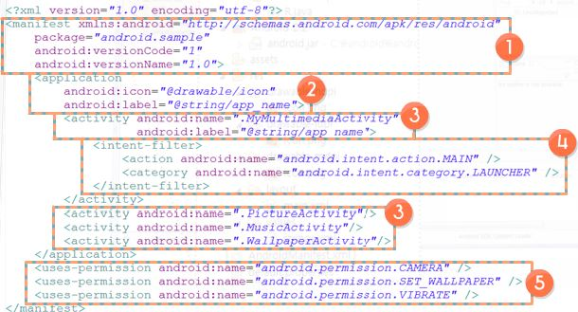
Example ofAndroidManifest.xml
1. <manifest> - package name, version info
2.<application> - app name and icon definition. Only one <application> under <manifest>
3.<activity>- Define activity among 4 component. Define class name and label
4.<Intent-filter>- <action> Define which jobs are processed. Component type. 4 activities are defined here
5.<uses-permission>- Permissions about resource. 3 permission (Camera, Set_wallpaper, Vibration) here

